Slide 1







SSB PRESENTS
ART GALLERY EVENT
YOUR HOSTS:
Nicole Imoru 221125414
Alvina Aamir 221749742
Kristina Acheampong 216219586
Syed Mustafa Moiz 221271754
Sajjadul Mawla 221743232
Nazila Najmul Chowdhury 221302054

Slide 2

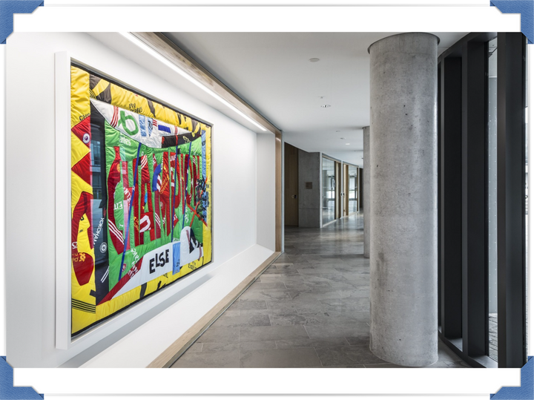

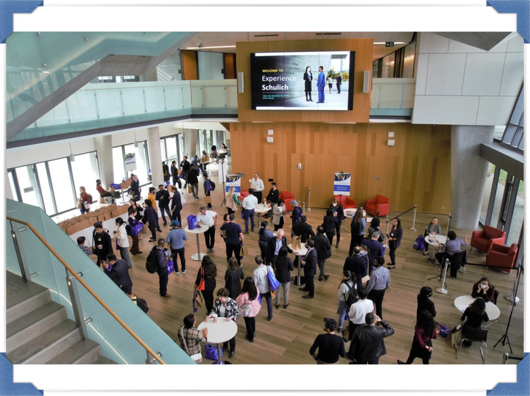
INTRODUCTION
EVENT PROPOSAL
Schulich Art Gallery Event Scheduled for September 21, 2025
Annual event celebrating and showcasing student creative talents
Platform for students to display and sell various forms of artwork
Highlights diverse abilities within the student body
Fosters artistic appreciation and community engagement
Networking opportunities with shared interests

Slide 3



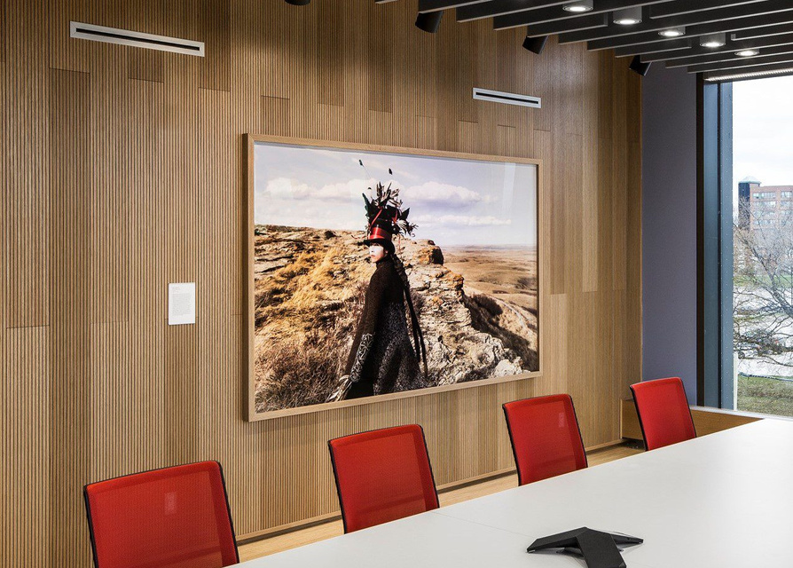




PROBLEM STATEMENT
Talented Artists in the Schulich Community lack a formal platform to showcase and sell their artwork, leading to missed opportunities for exposure, feedback, and monetization- while the Schulich community misses out on engaging with and appreciating its diverse artistic talents.

Slide 4



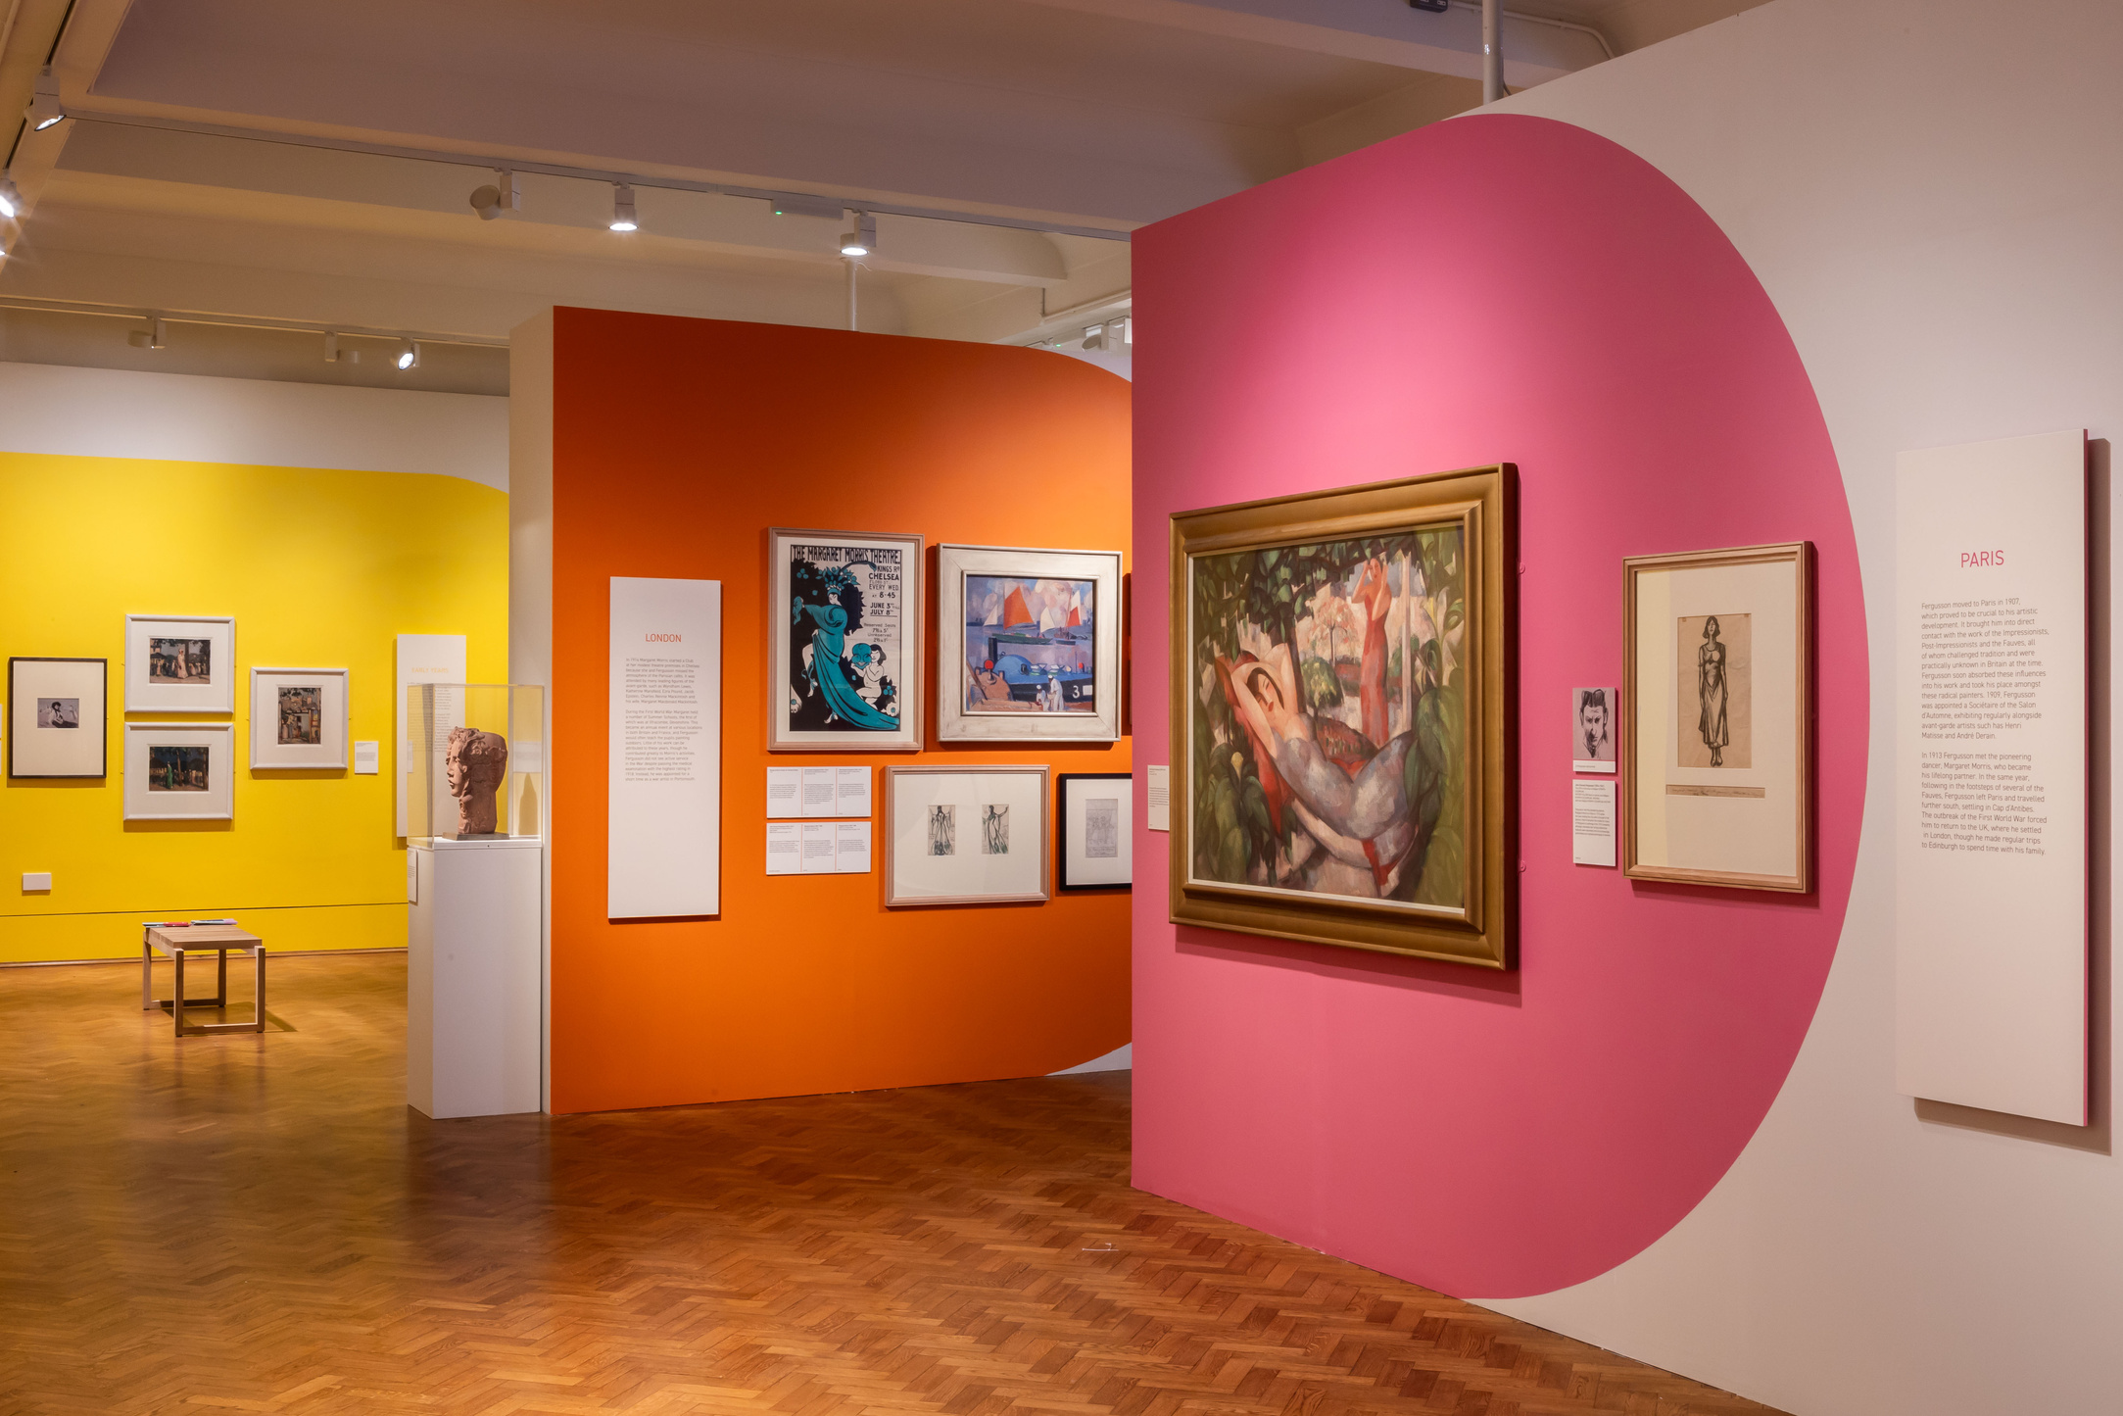


EVENT DETAILS & SOLUTION
ART
WORKSHOPS
Paintings, sculptures, embroidery, pottery, and other crafts
Attendees can create their own art with supplied materials
MARKETPLACE
REFRESHMENTS
During and after the event attendees can purchase the student's art
Light food and beverages will be available that accommodate all dietary restrictions

Slide 5








THE BENEFITS
SHOWCASE STUDENT TALENT
FOSTER ENTREPRENEURSHIP
COMMITMENT TO CREATIVITY
BUILD COMMUNITY
Give students a platform for diverse artistic expressions
Enhances student visibility and recognition
Real-world marketing and sales experience
Develops crucial entrepreneurial skills
Demonstrates Schulich’s dedication to nurturing student creativity
Enhances the school's appeal and reputation
Strengthens community within and beyond campus
Promotes a sense of belonging and support

Slide 6

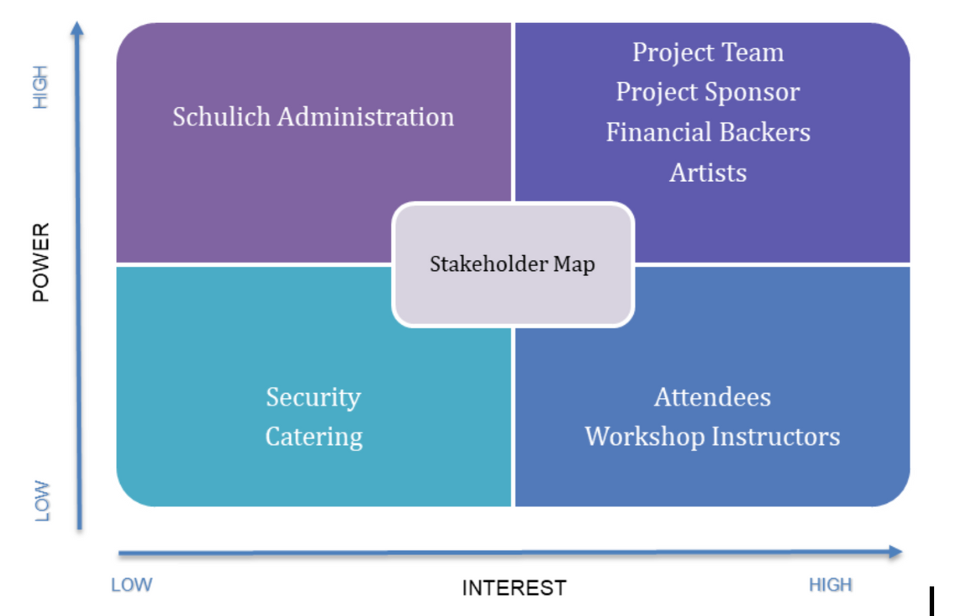
STAKEHOLDER ANALYSIS
Project team
Instructors
Project Sponsor
Caterers
Administration
Volunteers
Security
Attendees
Artists
Financial Backers

Slide 7


RISK SEVERITY MATRIX
Risk ID | Risk Event | Likelihood (L) | Impact (I) | Detection Difficulty (D) | Risk Value (LID) | Risk Zone
1 | Low participant and attendee turnout | 3 | 4 | 2 | 24 | Yellow Zone (moderate)
2 | Insufficient funding | 3 | 5 | 2 | 30 | Red Zone (critical)
3 | Logistical issues | 2 | 4 | 3 | 24 | Yellow Zone (moderate)
4 | Health and safety concerns | 3 | 4 | 2 | 24 | Yellow Zone (moderate)
5 | Artwork damage or theft | 2 | 5 | 2 | 20 | Yellow Zone (moderate)

Slide 8
RISK ASSESSMENT FORM
Risk ID | Risk Event | Likelihood (L) | Impact (I) | Detection Difficulty (D) | Risk Value (L/D) | When | Mitigation Strategy | Contingency Plan
1 | Low participant and attendee turnout | 3 | 4 | 2 | 24 | Before Event | Increased Promotion | Incentives, Early registration
2 | Insufficient funding | 3 | 5 | 2 | 30 | During Planning | Sponsorship Search | Apply for grants, donations
3 | Logistical Issues | 2 | 4 | 3 | 24 | During Event Setup | Detailed planning | Backup equipment and materials
4 | Health and Safety Concerns | 3 | 4 | 2 | 24 | During Event | Safety Protocols | First Aid Kit, Site Safety
5 | Artwork Damage or Theft | 2 | 5 | 2 | 20 | During Event | Security Measures | Secure Display Methods

Slide 9

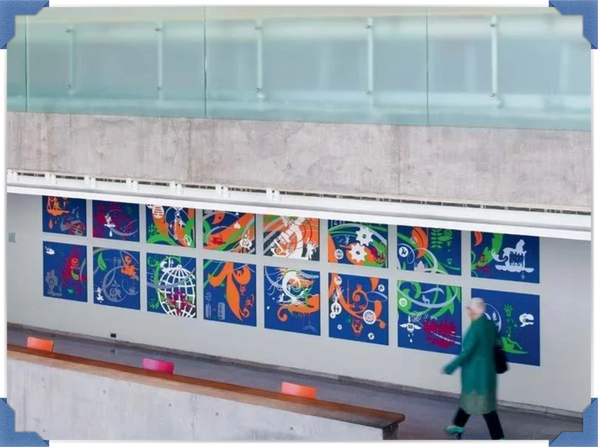
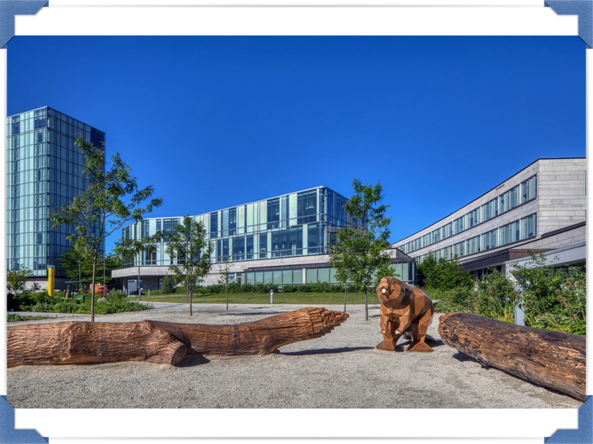
FUNDING
SPONSORSHIPS
DONATIONS
TICKET SALES
PARTNERSHIPS
GRANTS
Securing financial support from local businesses and corporate sponsors to enhance credibility and reach
Engaging alumni and community members to foster a sense of community involvement and supplement the budget
Generating revenue through ticketed workshops or premium event access, ensuring commitment from attendees
Forming strategic partnerships for in-kind contributions like catering services or art supplies to reduce costs
Applying for grants from arts councils and philanthropic organizations to secure significant financial resources for the event

Slide 10
BUDGET
Month | Deliverables | Cost ($)
June | Event Planning and Management, Venue and Logistics | $2,000
July | Artwork and Vendor Management, Marketing and Promotion, Website Development | $4,800
August | Venue and Logistics, Food and Beverage, Workshop Coordination | $9,400
September | Venue and Logistics, Artwork and Vendor Management, Event Execution, Post-Event Activities | $7,200
October | Post-Event Activities | $700
Total | Total | $24,100
JUSTIFICATION
June: Securing the venue on time is critical.
July: Focus on collecting student artwork and launching marketing efforts to ensure broad outreach.
August: Infrastructure and setup costs dominate, ensuring a professional and engaging event.
September: Coordination and execution of the event, along with initial post-event activities, ensure a smooth event experience.
October: Wrap-up activities, including financial reporting and feedback collection, ensure a thorough closure.

Slide 11
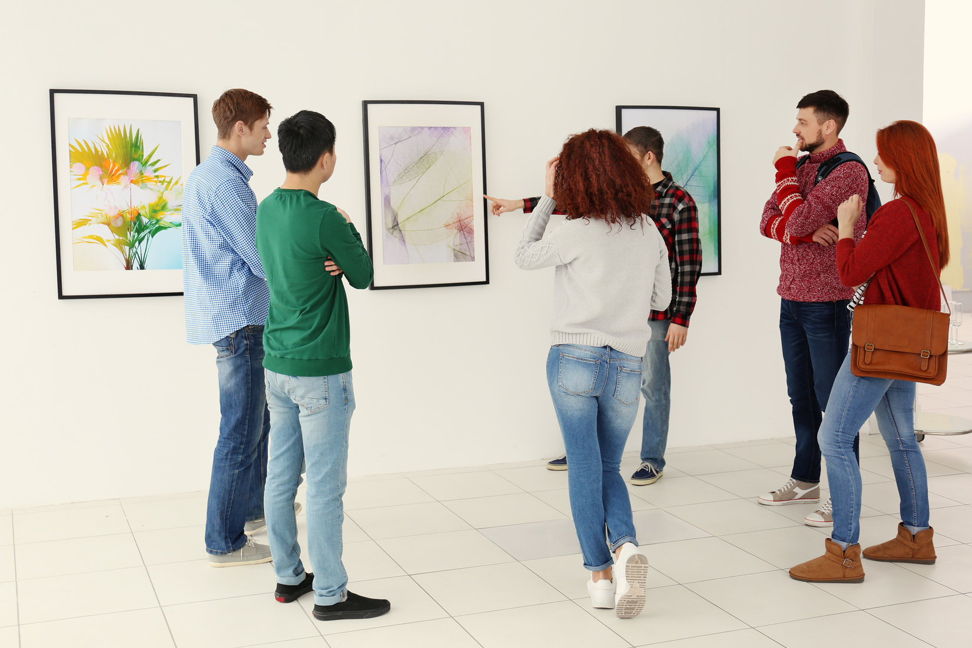
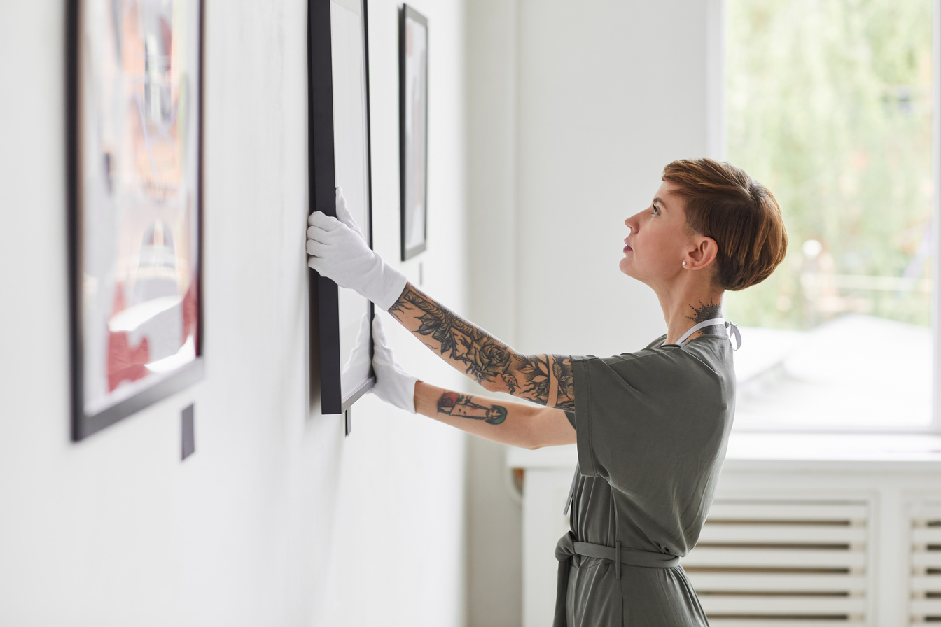
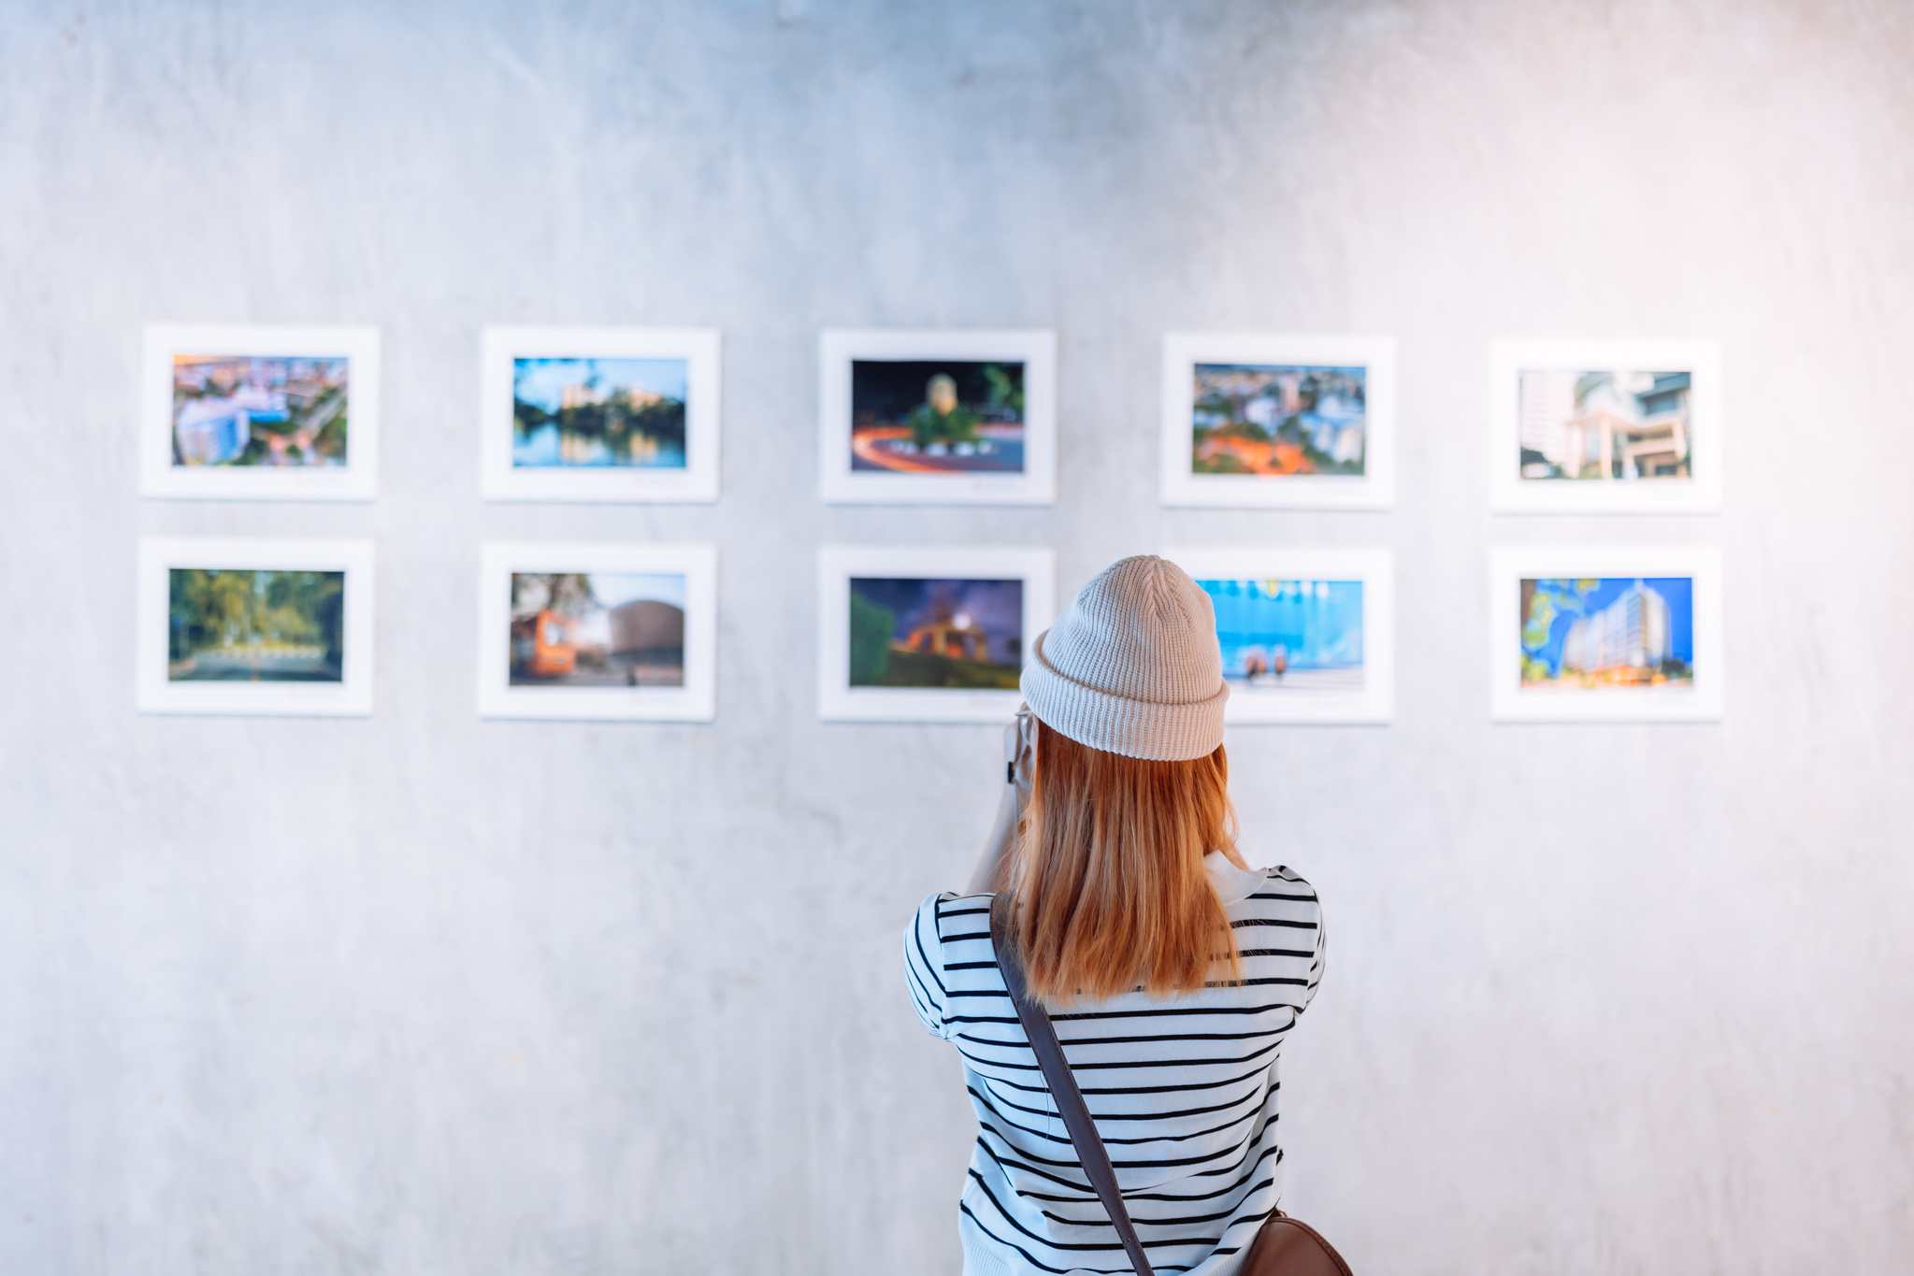


CONCLUSION
Combines hobbies and passions with practical business experience
Provides firsthand experience in selling artwork
Fosters a sense of community and enhances university reputation
Creates a platform we are proud to support
Aims to establish a lasting Schulich tradition
Thank you for your support!

